Slide 1
CEIS110 Module 5
Querying and manipulating data with SQL and Python

Slide 2
Rubric
Activity | Requirement(s) | Points
Python code | Screenshot of code | 20
Retrieve and convert data into CSV format | Screenshot of data in Excel file | 20
Temperature and Humidity chart | Chart of data from database | 20

Slide 3
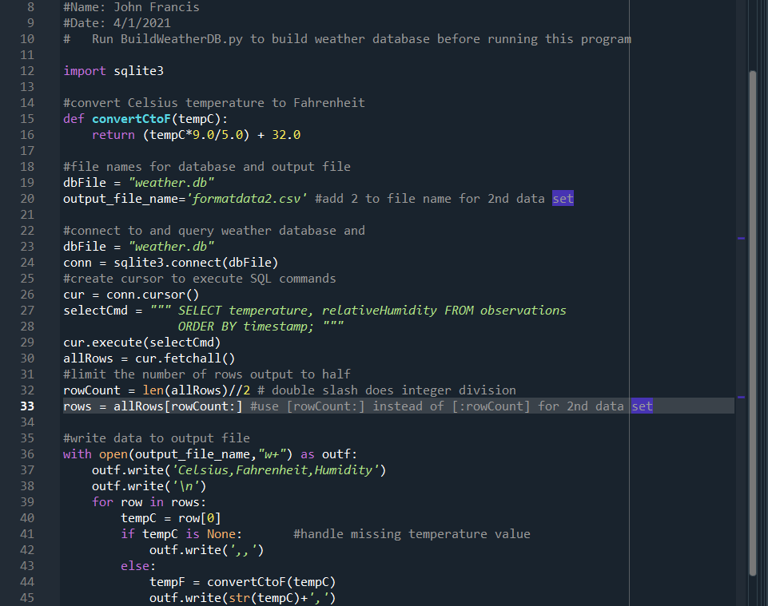
Python code (Screenshot or file)
ExtractTempHumidity.py Python code with your name and date in comments

Slide 4
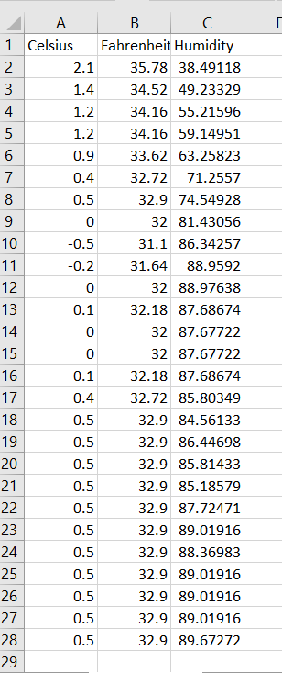
Retrieve and Convert Data to CSV Format (Screenshot)
Formatdata file open in Excel showing 3 columns of data

Slide 5
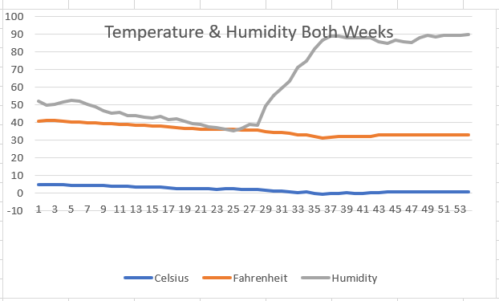
Temperature and Humidity Chart (Graph)
Excel chart based on temperature and humidity data from database

